Slide 1
Chapter 3
Software for Educators

Slide 2
Chapter Objectives
Explain the role of an operating system and list the main operating systems used on today’s computers
Define and describe a user interface and a graphical user interface
Identify the important features of widely used software applications
Describe the advantages of software suites

Slide 3
Chapter Objectives
Explain how to create documents
Discuss why the use of video authoring and editing software is important for K-12 schools
Explain the difference between software application, Web application, and apps
Explain how to work with different versions of software applications

Slide 4
The Operating System
System Software
The programs that control and maintain the operation of the computer and its devices
The two parts of system software are the Operating System (OS) and utility programs.
Operating system (OS) (sometimes called the platform) coordinates all activities among computer hardware resources, applications and the user.
Utility programs are used to maintain the health of the operating system.

Slide 5
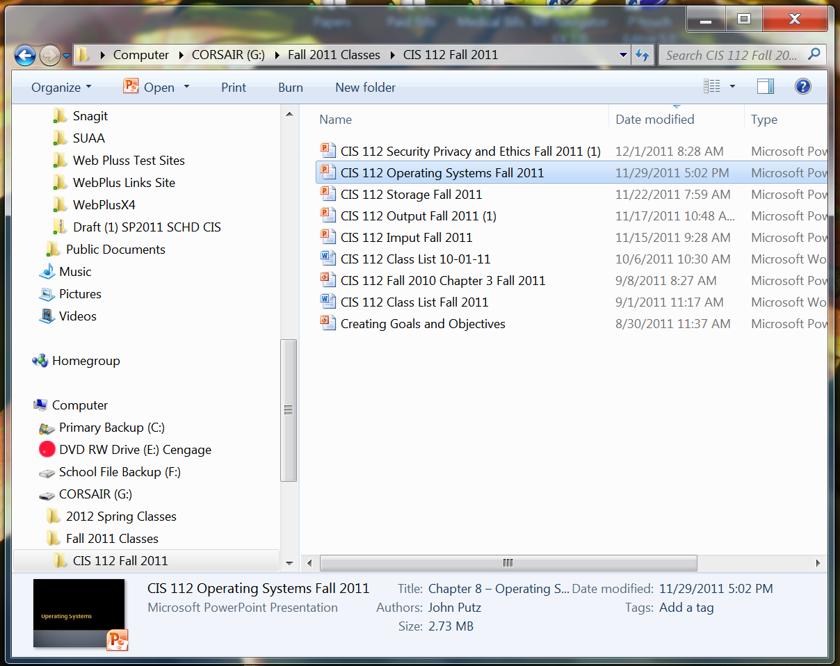
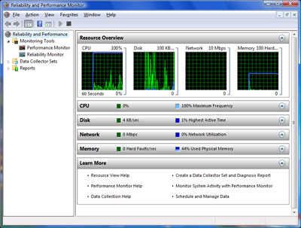
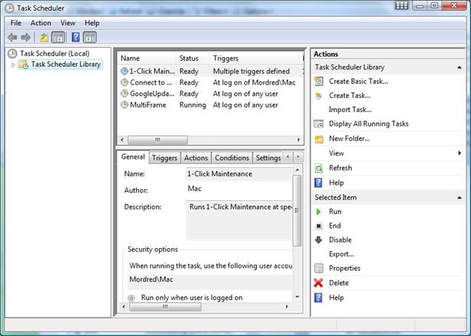
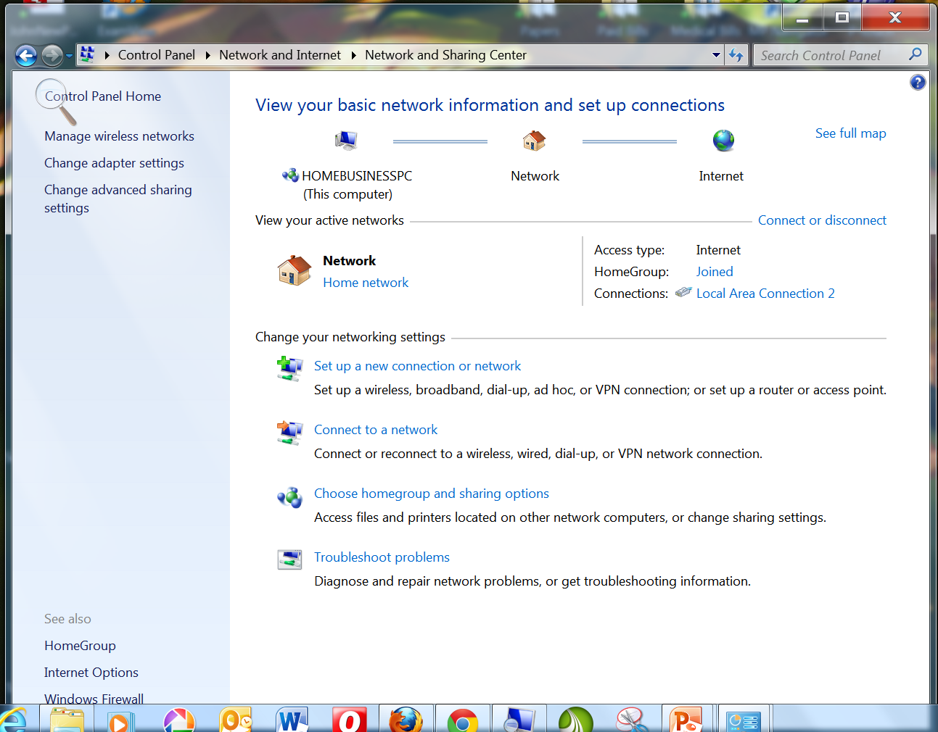
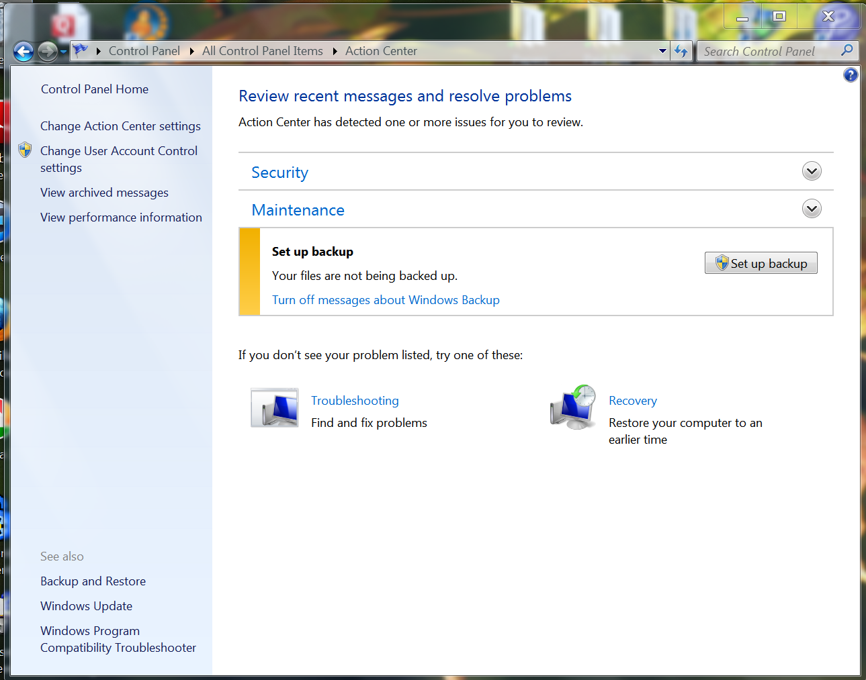
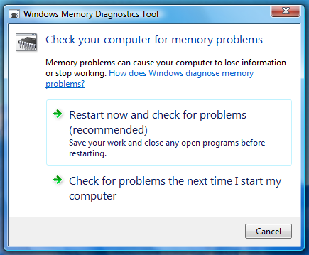
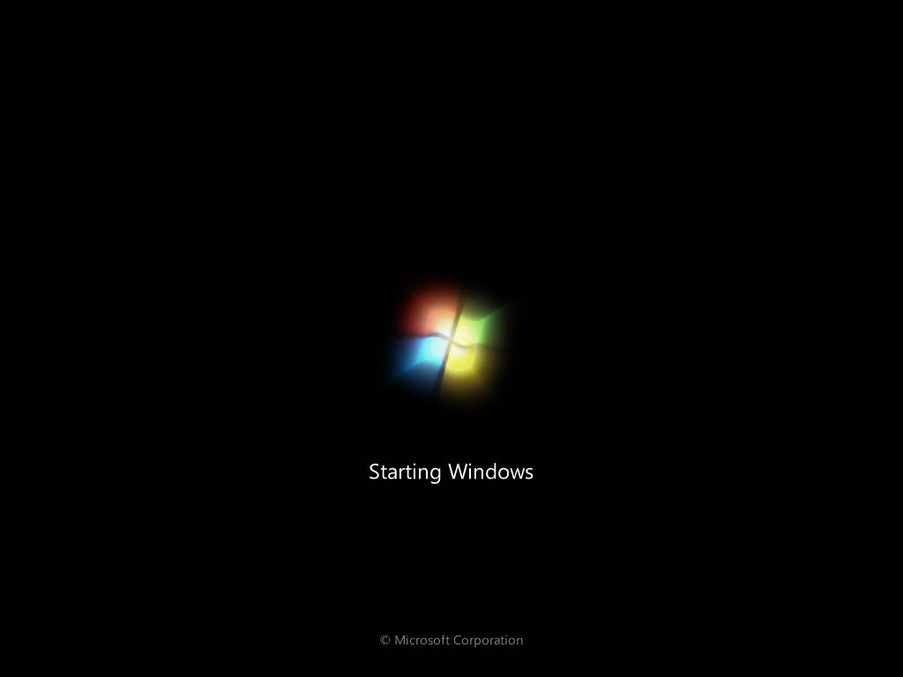
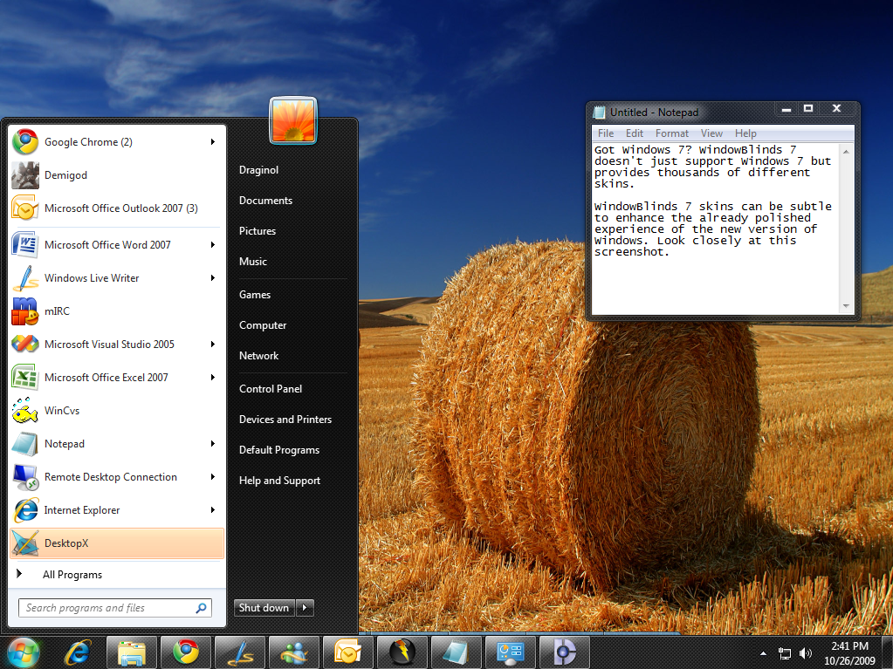
Operating System Functions
start up the computer
provide user interface
manage memory
schedule jobs and configure devices
control a network
administer security
Provide file management and other utilities
monitor performance

Slide 6
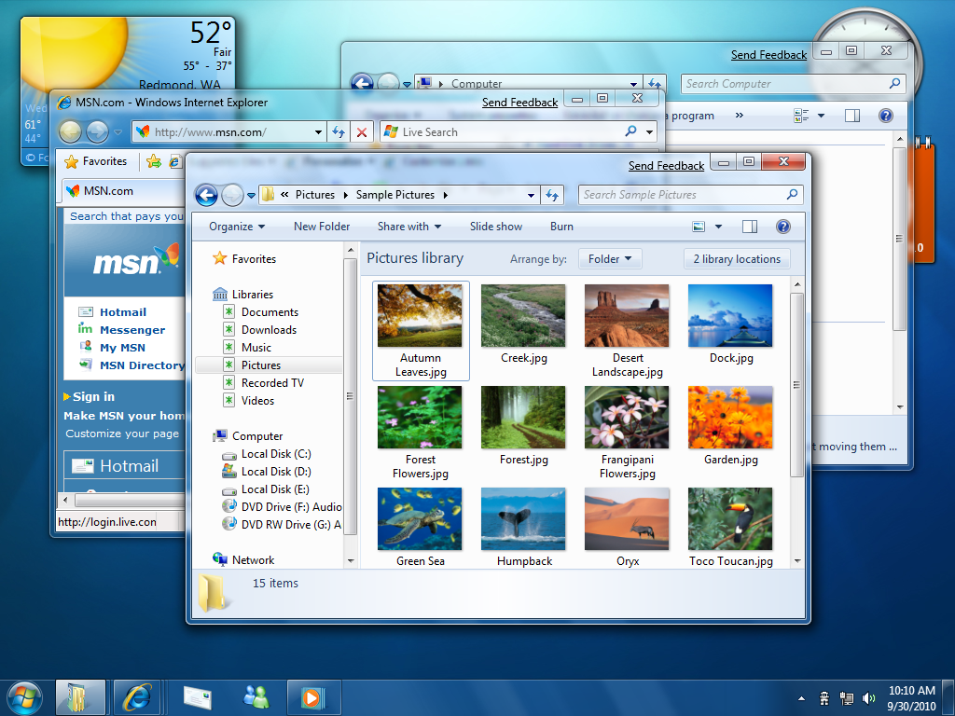
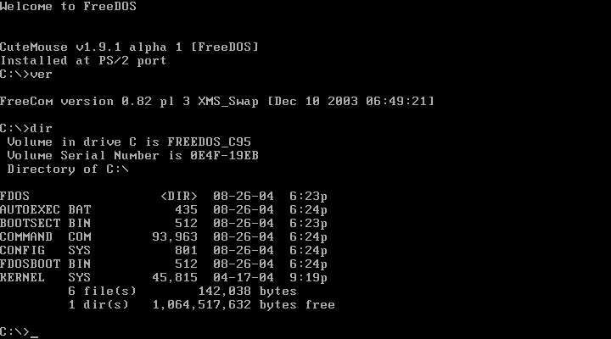
Differences Among Operating Systems
Most operating systems today use a graphical user interface (GUI), in which users can click icons or commands on the screen to issue instructions to the computer.
The older DOS operating system and some versions of the UNIX and Linux operating systems use a command line interface, which requires users to type commands to issue instructions to the computer.

Slide 7
Operating Systems – Configuring Hardware
When the OS starts up it must find and configure all of the hardware attached to the PC
It does this by using device drivers
This is a small program that tells the operating system how to configure and communicate with each peace of hardware.
Each device attached to a PC has a unique driver
These drivers are either found in the OS system or come with the hardware on a CD/DVD disk.

Slide 8
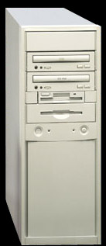
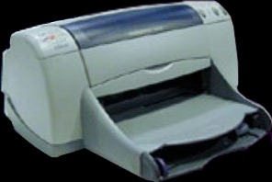
Operating System - Drivers
device driver

Slide 9
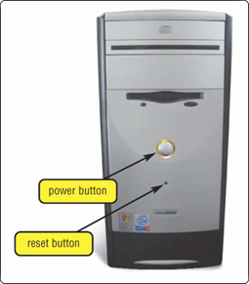
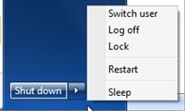
Operating System Start-up
cold boot
Process of turning on a computer after it has been powered off completely
warm boot
Process of restarting a computer that is already powered on

Slide 10
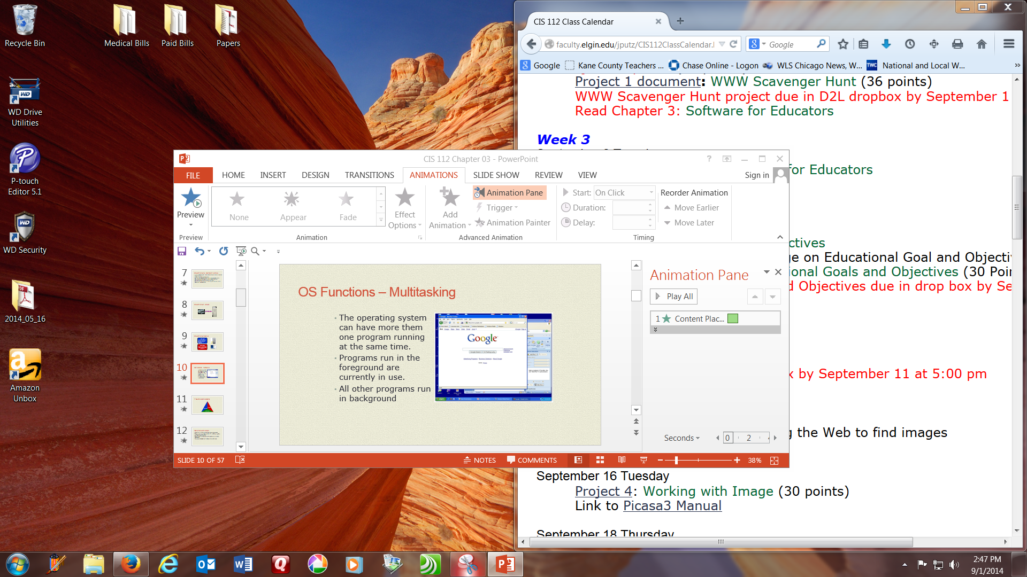
OS Functions – Multitasking
The operating system can have more them one program running at the same time.
Programs run in the foreground are currently in use.
All other programs run in background

Slide 11
Types of Operating Systems
Network
Embedded
Stand-alone

Slide 12
Network Operating System
There are a number of network operating systems
These systems are designed to link multiple computers and peripherals together

Slide 13
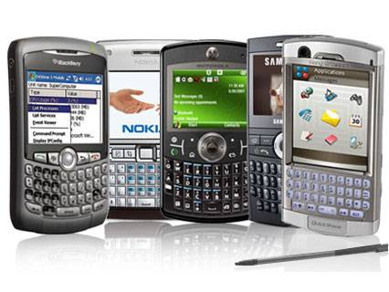
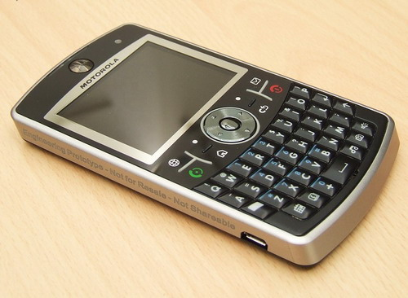
Embedded Operating Systems
Operating systems for mobile devices

Slide 14
Utility Programs
A system software that allows the user to perform maintenance type tasks including
Managing the computer
Its device
Its programs

Slide 15
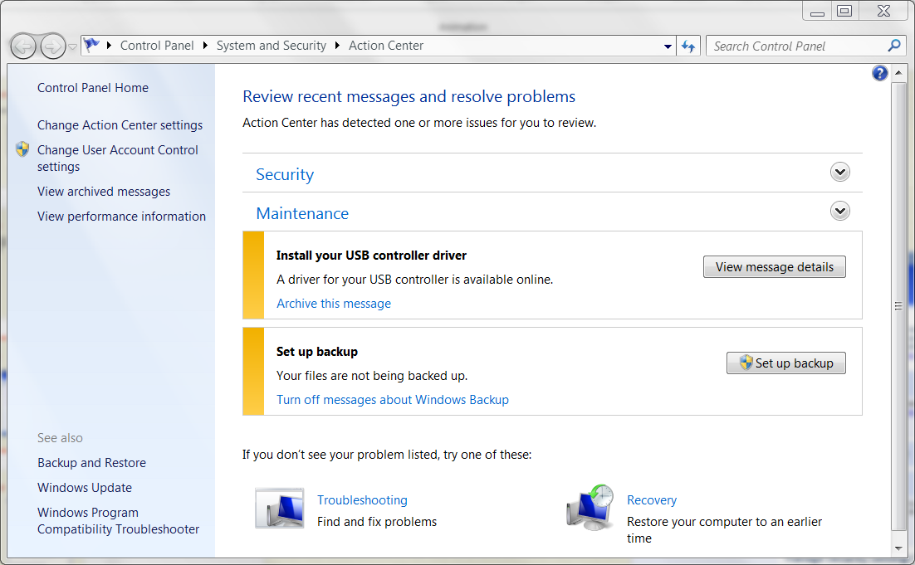
Action Center
Provides an overall view of the health of the operating system.
Contains utilities including
Anti-virus software
Firewall
Also shows any maintenance issues.

Slide 16
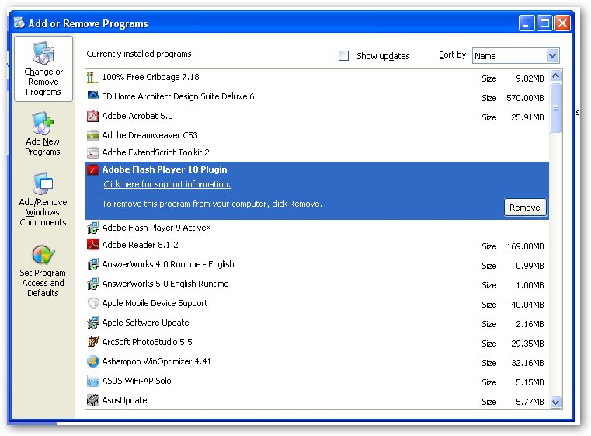
Uninstaller
Removes programs from the operating system.

Slide 17
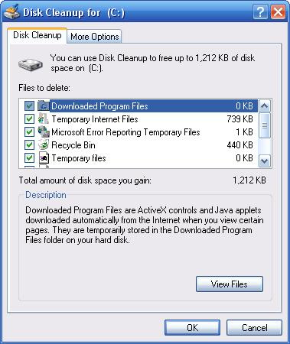
Disk Cleanup
A program that scans for unnecessary files
It then gives you the option to remove the files.

Slide 18
Application Software
Programs designed to perform specific tasks for users
As a productivity / business tool
Assisting with graphics and multimedia projects
Supporting school and professional activities
Helping with home and personal activities
Facilitating communications

Slide 19
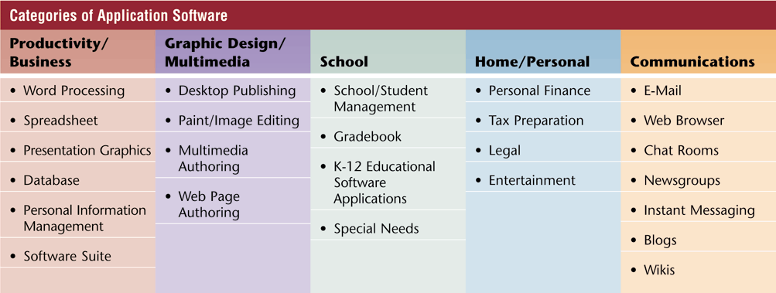
Application Software
Five major categories of application software
Notes:
Figure 3-3

Slide 20
Application Software
Working with Software Applications
Document - Piece of work created with an application
Creating
Editing
Formatting
Font
Font size
Font style
Printing
Saving
Dialog box
Voice recognition
Note taking software

Slide 21
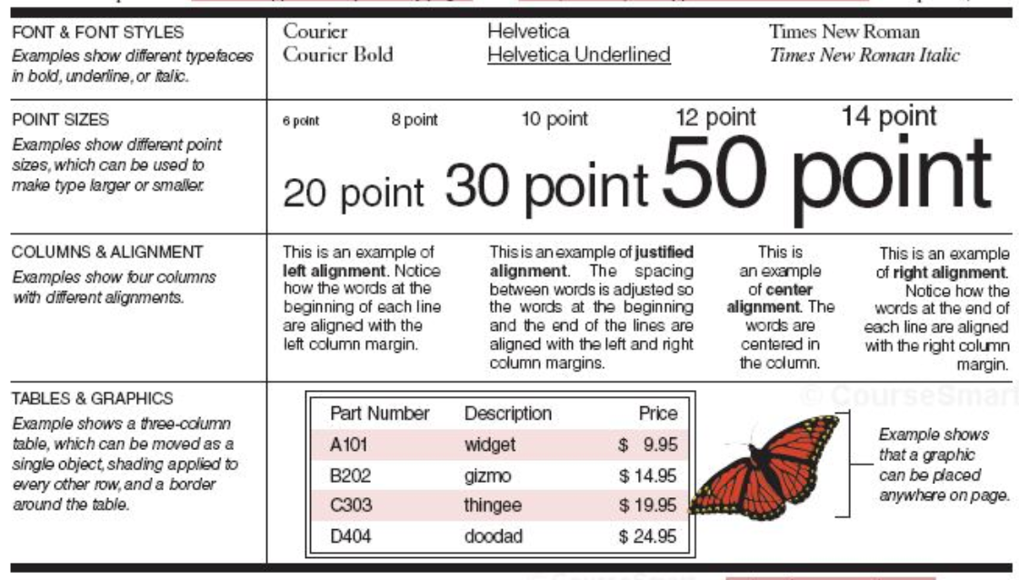
Application Software - Formatting
Notes:
Figure 3-6

Slide 22
Application Software – Save As Dialog Box

Slide 23
Application Software – Note Taking

Slide 24
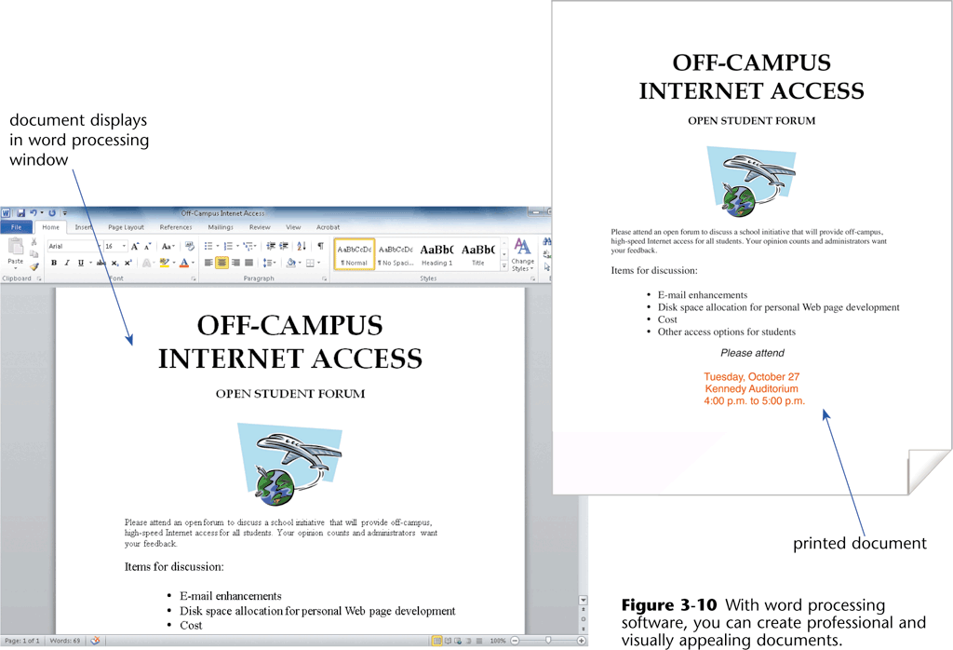
Productivity Software
Word Processing Software
Used to create, edit, and format textual documents

Slide 25
Productivity Software
Word Processing Software
Formatting features
Font and font size
Color
Borders
Clip art
Margins
Wordwrap
Scrolling

Slide 26
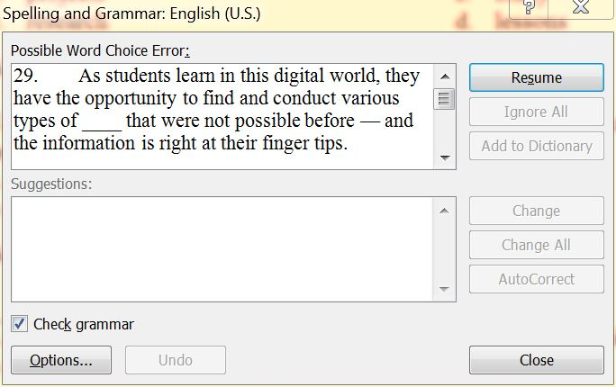
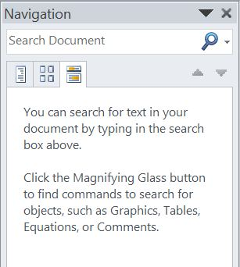
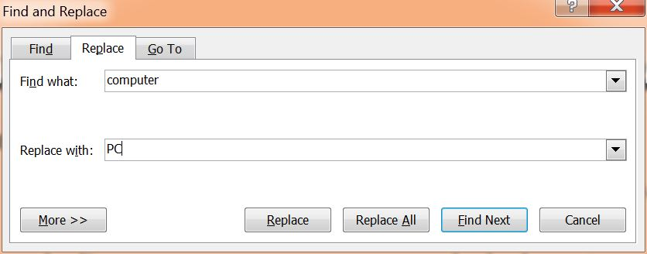
Productivity Software
Word Processing Software
Editing features
Find or search
Replace
Spell checker

Slide 27
Productivity Software
Refer to the chart on page 111 to see a more complete list of Word processing features.

Slide 28
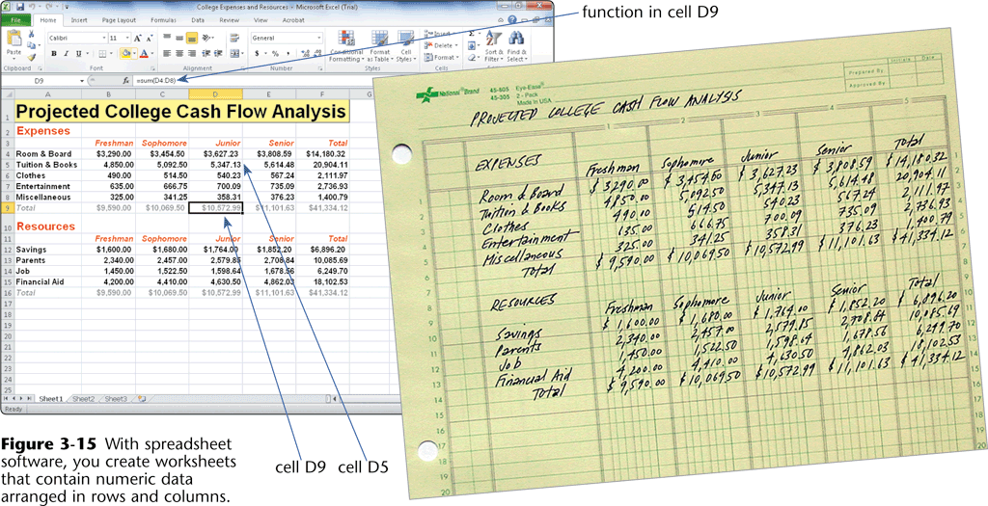
Productivity Software
Spreadsheet Software
Allows you to organize numeric data in rows and columns, collectively called a spreadsheet or worksheet

Slide 29
Productivity Software
Spreadsheet Software
Spreadsheet organization
Worksheet has columns and rows
Cell - Intersection of a row and a column
Cells can contain
Labels
Values
Formulas
Web addresses
Multimedia
Calculations
Formula - Performs calculations on data in the worksheet and displays the results in a cell
Function – A predefined formula that performs common calculations

Slide 30
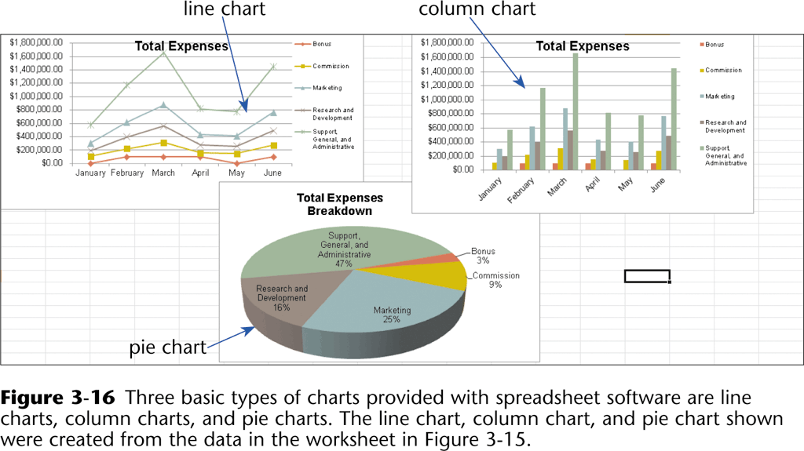
Productivity Software
Spreadsheet Software
Charts
Graphically illustrates the relationship of numeric data

Slide 31
Productivity Software
Database Software
Database - A collection of data organized in a manner that allows access, retrieval, and use of that data
Similar to a manual filing system
Database software is where all of the information collected from forms either online or hard copy are kept.
Information in the form of reports are generated from that information.

Slide 32
Productivity Software
Presentation Graphics Software
Allows you to create documents called presentations which are used to communicate ideas, messages, and other information to a group
Predefined formats - define colors and other elements for backgrounds, text, and other special effects
Various slide layouts
Clip art / image gallery
Integrating electronic presentations into the classroom
Nonlinear teaching and learning
Students and teachers create presentations
Can link to other slides, presentations, and to the Web

Slide 33
Productivity Software
Personal Information Managers (PIM)
Software application that includes an appointment calendar, address book, notepad, and other features to help organize appointments, task lists, and more

Slide 34
Application Programs, Web Applications, and Apps
A Web application, or Web app, is an application that allows users to access and interact with software from any computer or device that is connected to the Internet — which is sometimes called cloud computing
Many types of application software are available as Web applications
Thousands of games are available
Experts often use the term Web 2.0 to describe Web applications
Web applications and application software programs are usually multipurpose programs
Application programs typically are installed on a computer before they are run, and Web applications are accessed via the Web

Slide 35
Application Programs, Web Applications, and Apps
Today, virtually all mobile device users download and use apps on their smartphones, tablet computers, and other mobile devices
An app, also called a mobile app, is a program you can download and use primarily on your mobile device
Apps often are single purpose programs

Slide 36
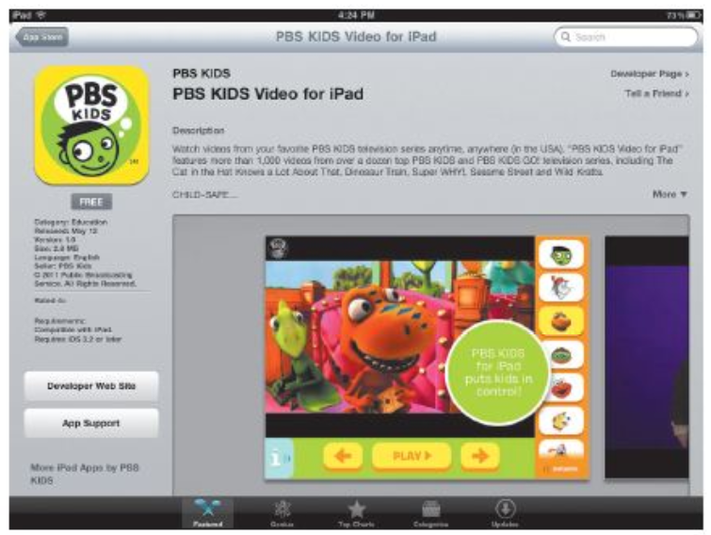
Application Programs, Web Applications, and Apps

Slide 37
Productivity Software
Software Suites
Collection of individual application software packages sold as a single package
Lower cost
Ease of use
Common interface

Slide 38
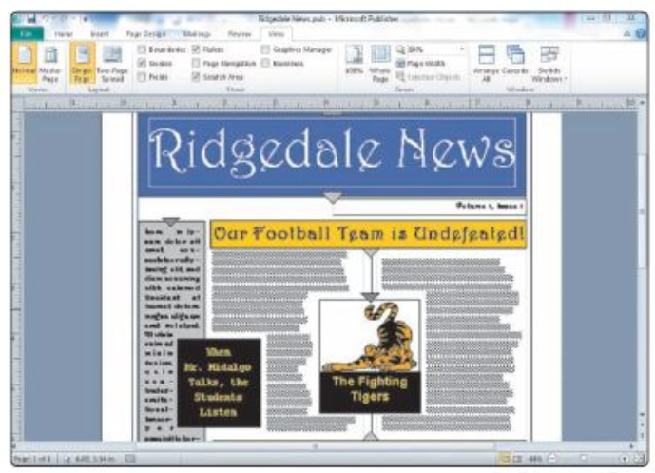
Graphics and Multimedia Software
Desktop Publishing (DTP) Software
Allows you to design, produce, and deliver sophisticated documents that contain text, graphics, and brilliant colors
Page layout - arranging text and graphics in a document

Slide 39
Graphics and Multimedia Software
Paint/Image-Editing Software
Allows you to draw pictures, shapes, and other graphical images using various tools on the screen
Paint software
Draw pictures, shapes, and other graphics
Image-editing software
Modify existing graphics
Photo editing software
Edit digital photographs

Slide 40
Graphics and Multimedia Software

Slide 41
Graphics and Multimedia Software
Clip Art/Image Gallery
Collection of clip art and photographs
Miscellaneous items
Fonts
Animations
Sounds
Video and audio files
Search engine image files.
Be careful of copyright

Slide 42
Graphics and Multimedia Software
Multimedia Authoring Software - used to create electronic presentations, simulations, and software demonstrations that can contain:
Text
Graphics
Video
Audio
Animation
Screen captures
Usually developed by professional

Slide 43
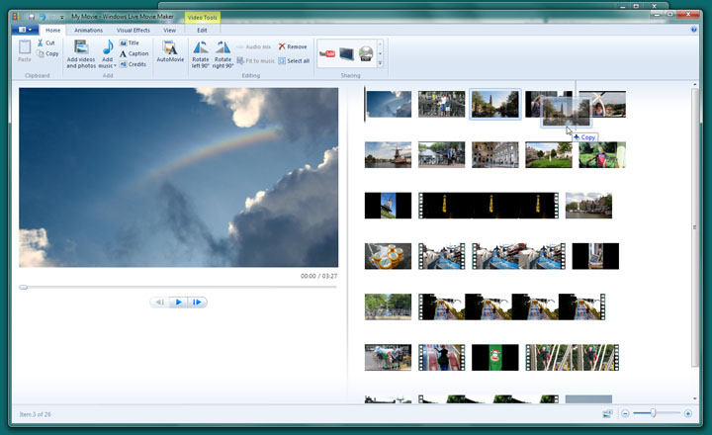
Graphics and Multimedia Software
Video and Audio Editing Software
Modify a segment of a video, known as a clip
Add and remove clips
Add special effects
Sounds
Banners
Credits

Slide 44
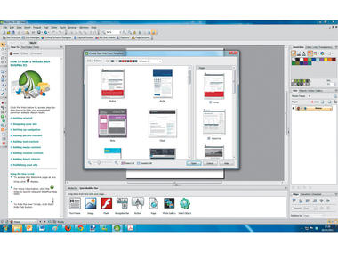
Graphics and Multimedia Software
Web Page Authoring Software
Allows you to create Web pages and organize, manage, and maintain Web sites
Many packages allow creation of Web pages
Word processing programs allow creation of web pages

Slide 45
Software for School Use
School and Student Management Software
School management software
Centralized program that allows district and school personnel to manage school district operations
Student management software
Allows administrators, teachers, and other staff to track information on students
Grade book Software
Allows teachers to track and organize student tests, homework, lab work, and other scores
Often integrates with other software packages

Slide 46
K-12 Educational Software
An educational software application refers to computer software products used to support teaching and learning of subject-related content
The number and quality of educational software applications designed specifically for the K-12 learning environment have increased dramatically in the past few years

Slide 47
K-12 Educational Software
Computer-assisted instruction is software designed to help teach facts, information, and/or skills associated with subject-related materials
Drill-and-practice software is software that first supplies factual information and then through repetitive exercises allows students to continue to work on specific materials to remember or memorize the information
Also called skills-reinforcement software
Remediation is reviewing content many times and using alternative means to help a student grasp the concepts being taughtAn educational game usually includes a set of rules, and students can compete against other students or the game itself
A tutorial is a teaching program designed to help individuals learn to use a product or concepts
Educational computer simulation or a video game is a computerized model of real life that represents a physical or simulated process
Integrated learning system (ILS) is a sophisticated software program usually developed by an established educational software corporation as a complete educational software solution in one package

Slide 48
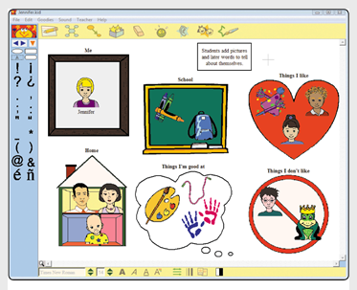
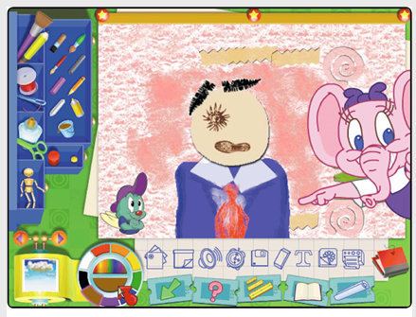
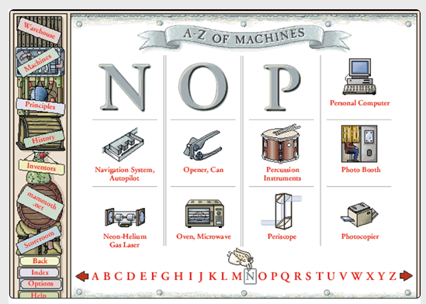
Curriculum-Specific Educational Software
Creativity applications often have students start with a blank canvas, which allows them to use their imagination and ingenuity
Critical-thinking applications stimulate students to use critical-thinking skills
Early learning applications are designed to provide students in grades PreK-3 with a developmental head start in reading, language arts, math, science, and other curriculum areas

Slide 49
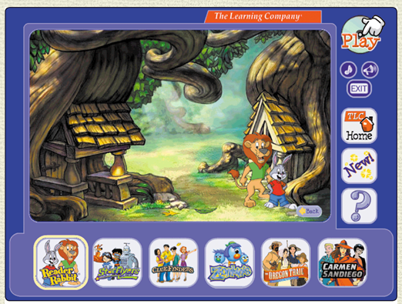
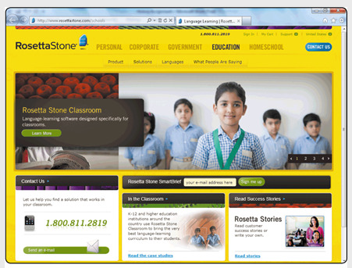
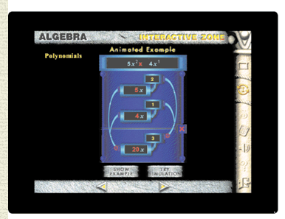
Curriculum-Specific Educational Software
ESL and foreign language applications provide K-12 students with assistance in learning English and other languages
Language arts applications support student learning throughout the reading and writing process
Math applications help students master basic and complex mathematics

Slide 50
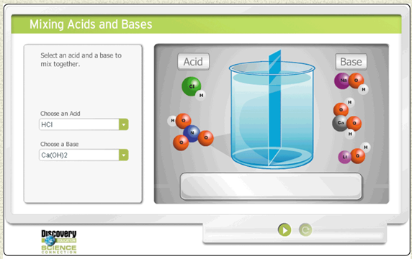
Curriculum-Specific Educational Software
Science applications are available for all grade levels and assist students in learning a wide variety of science concepts
Social studies applications encourage higher-order thinking skills, provide reinforcement of facts, and allow students to define their own path

Slide 51
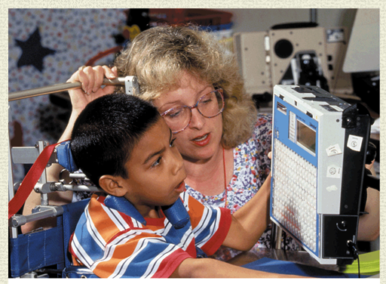
Curriculum-Specific Educational Software
Special needs software, also called assistive technologies software, is designed specifically for students with physical impairments or learning disabilities to assist them in completing school assignments and everyday tasks

Slide 52
Learning Aids and Support Tools
Help
Online help
Web-based help
Tutorials
FAQs

Slide 53
Software Versions and Upgrades
Software programs are designated by a version number
Upgrade is a new version designed to replace an older version
Using Different Software Versions
A school may have a mix of different software versions installed on its computers
Determine software version with the software’s About or Information command
Older version of software may not open files created with the newer version

Slide 54
Chapter Summary
Explain the role of an operating system and list the main operating systems used on today’s computers
Define and describe a user interface and a graphical user interface
Identify the important features of widely used software applications
Describe the advantages of software suites

Slide 55
Chapter Summary
Explain how to create documents
Discuss why the use of video authoring and editing software is important for K-12 schools
Explain the difference between software application, Web application, and app
Explain how to work with different versions of software applications

